Slide 1

CS 498 Probability & Statistics
Lecture 01
Notes:
How many of you have heard of the Schrodinger cat?

Slide 2
Course logistics
Class schedule
  MWF 11:00-11:50 am
  1214 Siebel Center.
Office hours
  TBD
Evaluation
  Homework, midterm, final
Instructor
  David Forsyth
  Email: daf@illinois.edu
  SC3310 (best way to reach)
TA: Zicheng Liao
  Email: liao17@illinois.edu
http://luthuli.cs.uiuc.edu/~daf/courses/Probcourse/Probcourse-2013/498-home.html

Slide 3

Where to start?

Slide 4
About matlab
“The language of technical computing”
  The language of MATRIX
Easy interface (C-like), simple syntax, and well-documented.
Interpreted rather than compiled
Cross-platform
Cross-language (matlab <==> C/C++)
Free student license!
Notes:
Raise your hand if you are
matlab experts,
familiar with matlab,
have used matlab once or twice,
never used but heard of,
first time hear it
What programming language have you used? C/C++, java, python, perl, bash

Slide 5
Install matlab
Half way to success
  Step 1: go to http://webstore.illinois.edu/home/
  Step 2: follow instructions.. And you’re all set

Slide 6
Install matlab
Half way to success
  Step 1: go to http://webstore.illinois.edu/home/
  Step 2: follow instructions.. And you’re most likely to run into sorts of problem
    Check out a matlab package (I am using R2012b)
    License.dat, installation file, and installation key.
    Strictly follow http://dl.webstore.illinois.edu/docs/ii/matlabconc.htm
    Tricky part: connect to the license manager on server
      Physically connected to campus network
      VPN (http://dl.webstore.illinois.edu/docs/ii/vpn.htm)
        Follow instructions.. And you’re all set.

Slide 7
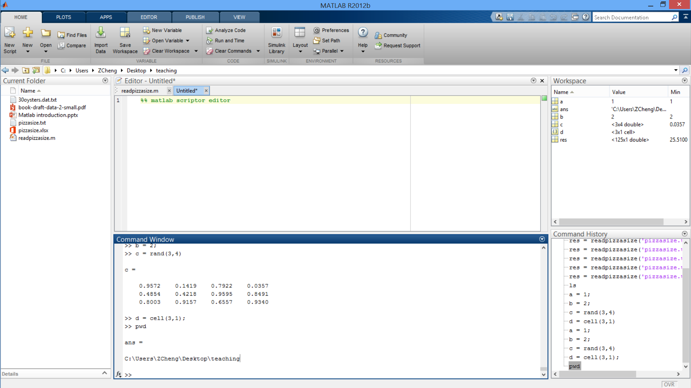
You’ve got here!

Slide 8
Create a scalar variable, vector, matrix
>> a = 1; b = 2; %create variable a=1, b=2
>> c = [1 0 1] %create a row vector
c =
1 0 1
>> c = [1, 0, 1] %comma is equivalent to ‘ ‘
c =
1 0 1
>> c = [1; 0; 1] %create a column vector with semicolons
c =
1
0
1
>> c = [1; 0 1] %rows must match in dimension
Error using ‘vertcat’
CAT arguments dimensions are not consistent.

Slide 9
Create a scalar variable, vector, matrix
>> d = [1 -2 0; 0 1 2] %create a 2x3 matrix
d =
1 -2 0
0 1 2
>> e = zeros(3,3) %create a 3x3 zero matrix
e =
0 0 0
0 0 0
0 0 0
>> f = ones(3,3) %create a 3x3 matrix with all 1
f =
1 1 1
1 1 1
1 1 1
>> g = rand(2) %create a 2x2 matrix with random values
g =
0.6557 0.8491
0.0357 0.9340

Slide 10
Indexing
>> a = [1 2 3 4 5 6 7 8 9 10];
>> a = 1:10 %quick way to create a sequence
a =
1 2 3 4 5 6 7 8 9 10
>> a(3) %retrieve the 3rd elm, 1-based indexing, C is 0-based
ans =
3
>> a(end) %retrieve the last element
ans =
10
>> a(2:6) %retrieve a sub-sequence
ans =
2 3 4 5 6
>> a(:)’ %colon retrieves the whole vector
ans =
1 2 3 4 5 6 7 8 9 10

Slide 11
Indexing
>> a = rand(3,3)
a =
0.6555 0.0318 0.0971
0.1712 0.2769 0.8235
0.7060 0.0462 0.6948
>> a(2,3) %retrieve element at row 2 column 3
ans =
0.8235
>> a(8) %column-major indexing; C is row-major
ans =
0.8235
>> a(1,:) %retrieve the whole first row
ans =
0.6555 0.0318 0.0971
>> a(2:3,1:2) %retrieve a sub-matrix
ans =
0.1712 0.2769
0.7060 0.0462
<c1>
<c2>
<c3>
<r1>
<r2>
<r3>

Slide 12
Basic operators: + - * /
>> a + b % a = 1, b = 2
ans =
3
>> c - a % vector - scalar
ans =
0 -1 0
>> a - c % scalar – vector, a = 1, c = [1 0 1]
ans =
0 1 0
>> c * b % =c * b, vector-scalar multiplication; commutative
ans =
2 0 2
>> c / b % vector divided by scalar, c = [1 0 1], b = 2
ans =
0.5000 0 0.5000
>> b / c % scalar divided by vector
Error using /
Matrix dimensions must agree.

Slide 13
Basic operators: + - * / .* ./
>> c + d % vector plus vector c = [1 0 1], d = [2 2 -1]
ans =
3 2 0
>> c + 1:5 % a 1x3 vector plus a 1x5 vector
Error using +
Matrix dimensions must agree.
>> e = [2; 2; -1] % a 3x1 column vector
e =
2
2
-1
>> c + e % a row vector plus a column vector
Error using +
Matrix dimensions must agree.
>> e’ % transpose of e
ans =
2 2 -1
>> c + e’
ans =
3 2 0

Slide 14
Basic operators: + - * / .* ./
>> c*d %c = [1 0 1], d = [2 2 -1]
Error using *
Inner matrix dimensions must agree.
>>c*d’ %dot product
ans =
1
>> c.*d %element-wise operation, [1*2 0*2 1*(-1)]
ans =
2 0 -1
>> c./d
ans =
0.5 0 -1.0
>> e = 1:5;
>> c./e
Error using ./
Matrix dimensions must agree.

Slide 15
Basic operators: + - * / .* ./
%---implement dot product of two vectors---%
>> c = [1 0 1]; d = [2 2 - 1];
%C-style impl: always try to avoid for loops if possible
>> ans = 0;
>> for i = 1:length(c)
ans = ans + c(i)*d(i);
end
>> disp(ans);
1
%matlab way of doing it
>> c*d’; %already shown
>> dot(c, d); %matlab built-in function
>> sum(c.*d) %your way of doing it explicitly
ans =
1

Slide 16
Basic operators: ^ .^
>> 5^2 % 5 to the power of 2
ans =
25
>> d^2 % d = [2 2 - 1]
Error using ^
Inputs must be a scalar and a square matrix.
>> d.^2
ans =
4 4 1
>> 2.^d % scalar .^ vector
ans =
4.0000 4.0000 0.5000
>> d.^c % vector .^ vector, c = [1 0 1]
ans =
2 1 -1

Slide 17
Logical subscripting
Logical operators: &(and), |(or), xor, a>b, etc
>> if (2 > 3) || (1&1 )
disp('true');
else
disp('false');
end
true
>> a = 1:4; %a=[1 2 3 4]
>> res = a>2
res =
0 0 1 1 %logical type

Slide 18
Logical subscripting
Logical operators: &(and), |(or), xor, a>b, etc
>> a = 1:4; %a=[1 2 3 4]
>> res = a>2
res =
0 0 1 1 %logical type
%--- continue from here---%
>> a(a>2) %=a(logical([0 0 1 1])), not a([0 0 1 1])
ans =
3 4
%%
>> a = randn(1, 10000); % 10000 samples from normal distribution
>> sum(a<1 & a>-1)/10000 %guess an answer..
ans =
0.6732 %1-sigma of normal distribution

Slide 19
Concatenate
>> a = [1 2];
>> a = [a 3] %concatenate a scalar
a =
1 2 3
>> a = [a [3 2 1]] %concatenate a with a vector
a =
1 2 3 3 2 1
>> b = 1:6; a = [a; b] %concatenate in the vertical dim
a =
1 2 3 3 2 1
1 2 3 4 5 6
>> a = [a; 1:7] %dimension must match
Error using vertcat
CAT arguments dimensions are not consistent.

Slide 20
Delete
>> a
a =
1 2 3 3 2 1
1 2 3 4 5 6
>> a(1,:) = [] %delete the first row
a =
1 2 3 4 5 6 %matrix size changed
>> a(2:3) = [] %delete two elements in a vector
a =
1 4 5 6
>> a(2) = [] %delete one more element
a =
1 5 6

Slide 21
Online resources
A quick tutorial
  http://web.eecs.umich.edu/~aey/eecs451/matlab.pdf
Get started with matlab
  http://www.mathworks.com/help/pdf_doc/matlab/getstart.pdf
Matlab online document (everything is here!)
  http://www.mathworks.com/help/matlab/
  >> doc func_name
  >> doc; search with key words

Slide 22


First tools for looking at Data
It’s all about data
“what’s going on here?”
Descriptive statistics
Look into data (make sense of what’s going on)
Not working..
Bingo!
Problem
+
Data
Algorithm
Re-design algorithm
Notes:
Have you worked on a project that has real data involved in?

Slide 23
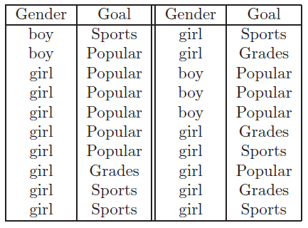
Datasets
School dataset
http://lib.stat.cmu.edu/DASL/Datafiles/PopularKids.html

Slide 24
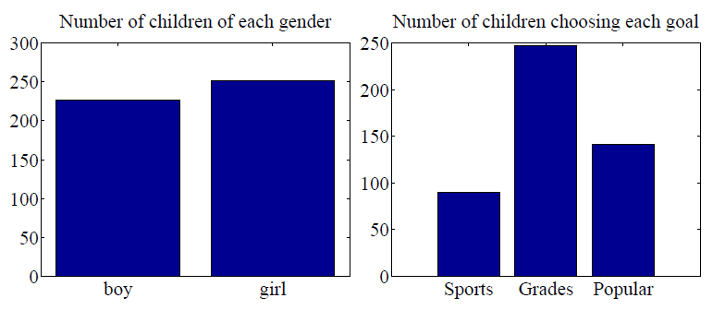
Bar charts
Count of categorical data
matlab\plotschooldata.m
(Walk through the whole process)

Slide 25
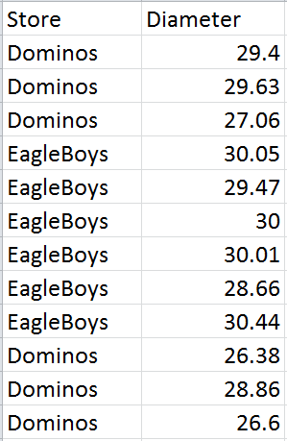
Datasets
Pizza size dataset
http://www.amstat.org/publications/jse/jse_data_archive.htm

Slide 26
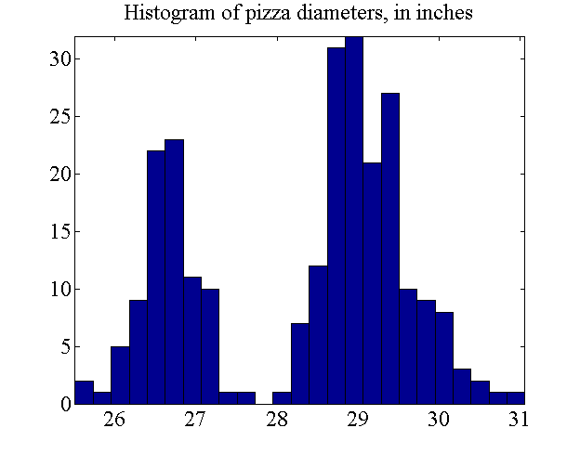
Histogram
Count of continuous data in even (or uneven) intervals
matlab\plotpizzasize.m

Slide 27
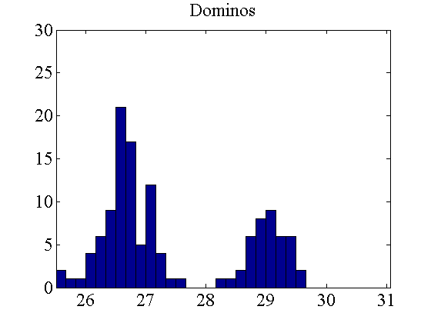
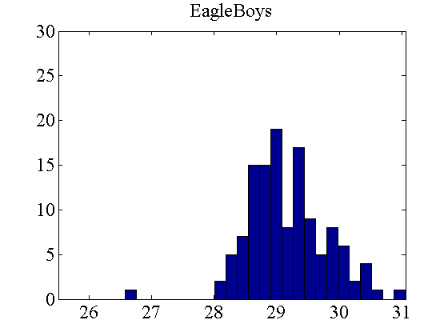
Class-conditional histogram
Histogram of a certain class
matlab\plotpizzasize_condhist.m

Slide 28
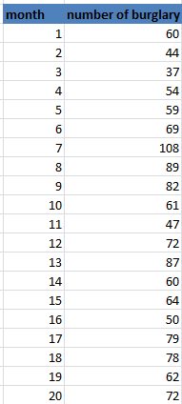
Series data
Number of burglaries each month in Hyde Park
http://lib.stat.cmu.edu/DASL/Datafiles/timeseriesdat.html

Slide 29
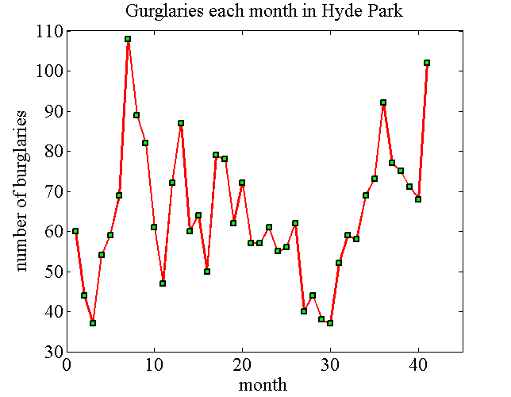
Plot series data
matlab\plotburglary.m

Slide 30
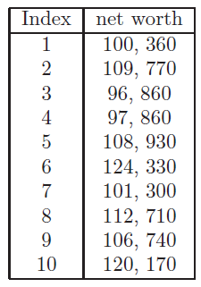
Summarizing 1D data
  Mean
  Standard deviation
  Variance
  Median
  Percentile
  Interquartile range
Net worth of people you meet in a bar

Slide 31

Mean
  Mean: $mean\left(\left\{x\right\}\right)= \frac{1}{N}\sum_{i=1}^{N}{x_{i}}$
>> a = [1 2 3 5 6];
>> mean(a)
ma =
3.4
>> a = [1 2 3; 4 5 6];
>> mean(a) %by default, take mean per-column
ans =
2.5000 3.5000 4.5000
>>mean(a, 2) %take mean in the 2nd dimension (row)
ans =
2
5

Slide 32
Median
  Median: The data half way along the sorted data points
>> a = [1 2 3 5 6];
>> median(a)
ma =
3
>> a = [a 6]; %a = [1 2 3 5 6 6]
>> median(a) %take the mean of the two middle points
ans =
4
>> median([1 2 2 2 2 2 5 10 15 100]) %biased measure
ans =
2

Slide 33

Std. and variance
  Standard deviation: $std\left(\left\{x\right\}\right)= \sqrt{\frac{1}{N}\sum_{i=1}^{N}{{\left(x_{i}−mean\left(\left\{x\right\}\right)\right)}^{2}} }$
  Variance: $var\left(\left\{x\right\}\right)=\frac{1}{N}\sum_{i=1}^{N}{{\left(x_{i}−mean\left(\left\{x\right\}\right)\right)}^{2}}$
>> a = [1 2 3 5 6];
>> std(a)
ans =
2.0736 %not exactly by the formula
>> std(a,1) %based on the above formula
ans =
1.8547
>> var(a,1) %variance
ans =
3.4400
>> std(a,1)^2 %variance = std^2
ans =
3.4400
>> mean((a-mean(a)).*(a-mean(a))) %what var(a) does
ans =
3.4400

Slide 34

Percentile and interquartile range
  Percentile: The k-th percentile is the value such that $k\%$ of the data $x$ is less than or equal to.
  Interquartile range: $iqr\left(\left\{x\right\}\right)= prctile\left(x, 75\right)−prctile(x,25)$
>> a = rand(10000,1);
>> prctile(a, 20) %20th-percentile of 0-1 random samples
ans =
0.1991 %as expected
>> prctile(a, 80) %80th-percentile: ~0.8
ans =
0.7978
>> iqr(a) %interquartile range of a: ~0.5
ans =
0.4984
>> prctile(a, 75) - prctile(a, 25) %sanity check
ans =
0.4984

Slide 35
Summarizing 1D data
>> networths = [100360, 109770, 96860, 97860, 108930, 124330, 101300,… 112710,106740, 120170];
>> m = mean(networths)
m =
107903
>> sd = std(networths)
sd =
9.2654e+03
>> v = var(networths)
v =
8.5848e+07
Net worth of people
you meet in a bar

Slide 36
Summarizing 1D data
>> bnetworths = [networths, 1e9];
>> bm = mean(bnetworths)
bm =
9.1007e+07
>> bsd = std(bnetworths)
bsd =
3.0148e+08
>> bv = var(bnetworths)
bv =
9.0889e+16
11 | 1e9
A billionaire comes in
Sensitive to outliers!

Slide 37
Summarizing 1D data
>> md = median(networths)
md =
107835
>> bmd = median(bnetworths)
bmd =
108930
11 | 1e9
Networths with a billionaire

Slide 38
Summarizing 1D data
>> pcts = prctile(networths, [25 50 75])
pcts =
100360 107835 112710
>> bpcts = prctile(bnetworths, [25 50 75])
bpcts =
100595 108930 118305
>> interqtl = iqr(networths)
interqtl = 12350
>> binterqtl = iqr(bnetworths)
binterqtl = 17710
11 | 1e9
Networths with a billionaire

Slide 39
The pizzasize puzzle
Understand what’s going on
Look at other labels: type of crust and type of topping
Cannot compare many histogram together
  Need a more compact plot

Slide 40
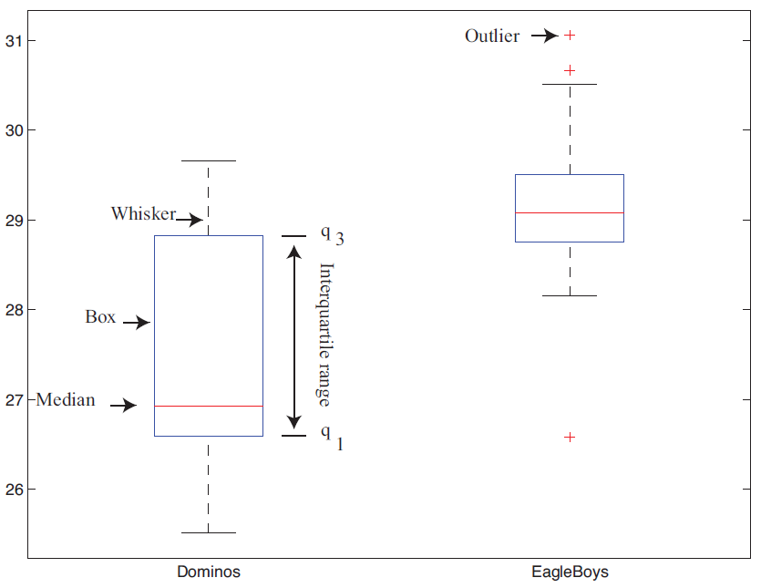
boxplot
More compact way of summarizing data than histogram
>> boxplot([dsizes esizes], 'whisker', 1.5);

Slide 41
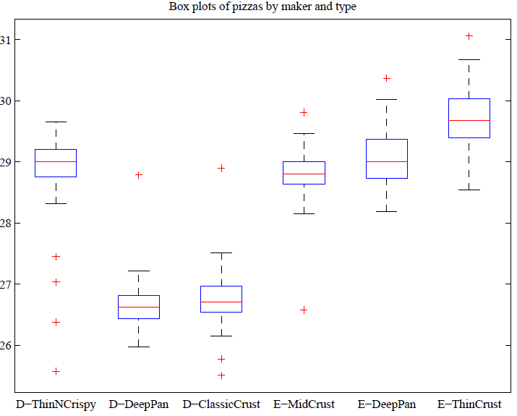
Boxplot with type of crust
EagleBoys has tighter control over size
Dominos ThinNCrispy is unusual
  shrinking during baking
  control portion by weight
  mistakes by chef (?)

Slide 42
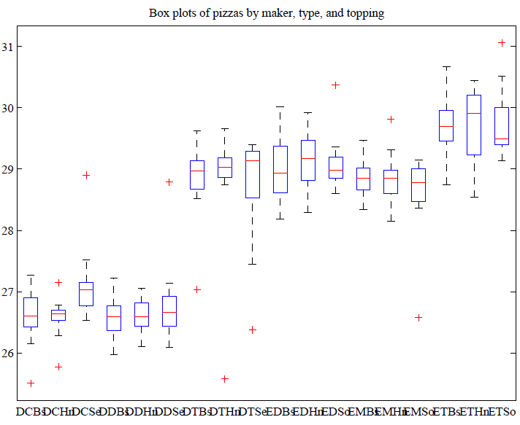
Boxplot with crust and topping
Dominos
EagleBoys

Slide 43
Wrap-up
“A matlab start is half way to success”
It’s all about data.
  Plot data with bar chart, histogram, series plot and box plot.
  Summarize 1D data with mean, std, variance, median, percentile and interquartile range.

